Slide 1
COT5615: Math for Intelligent Systems I
Anand Rangarajan

Slide 2
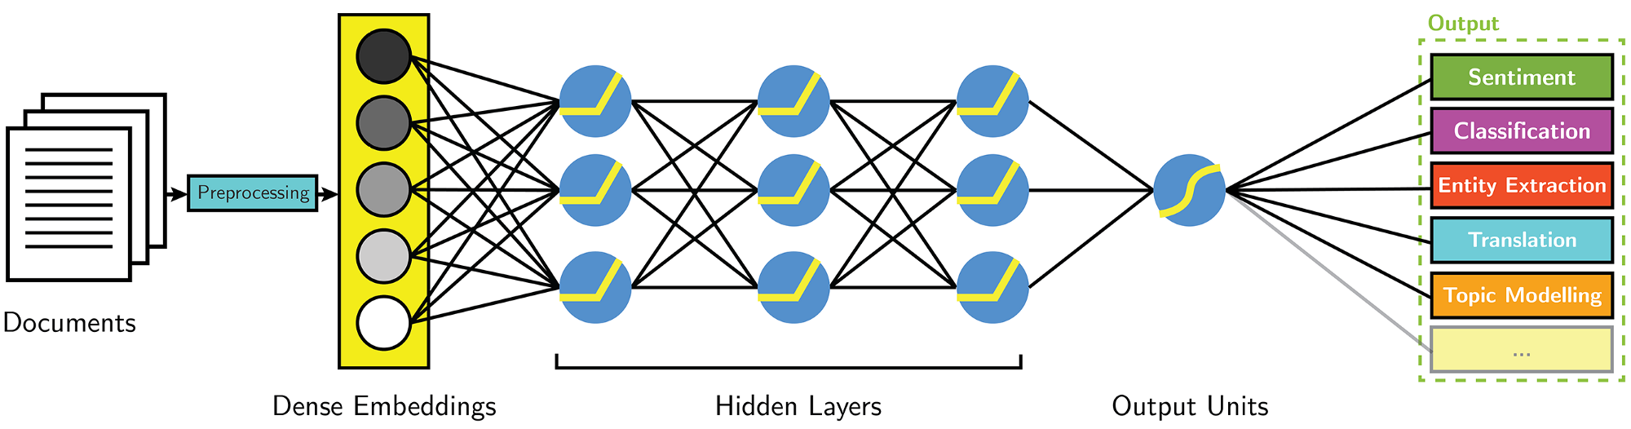
WHY?
Not the only architecture that matters

Slide 3
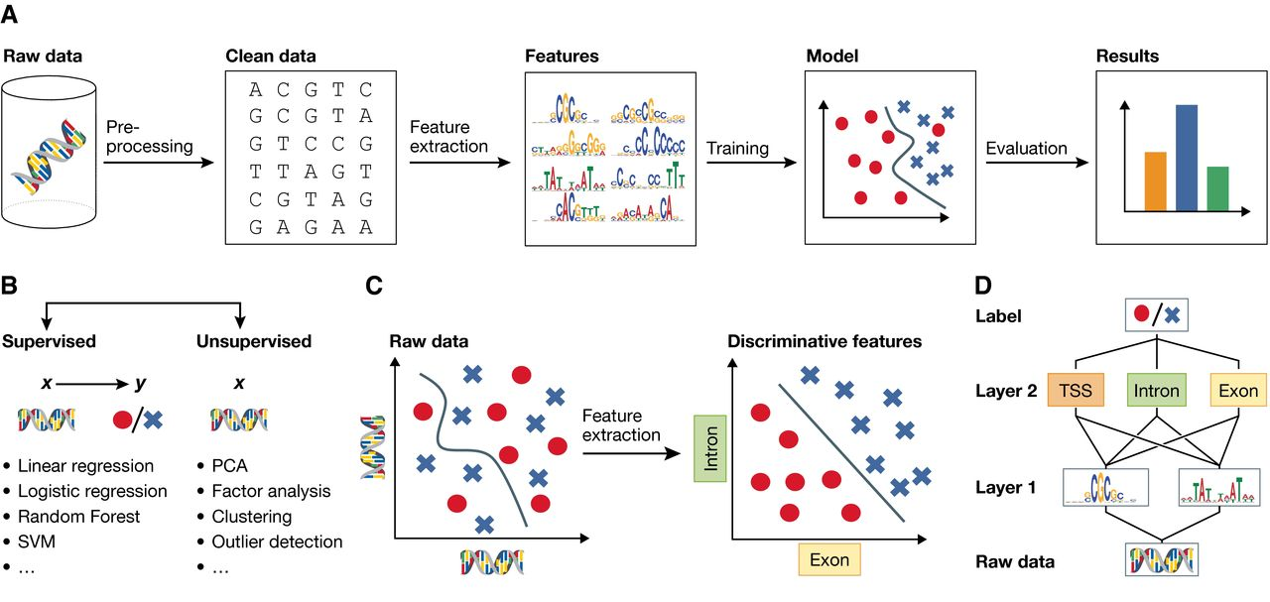
BIG PICTURE
Applied math runs the show

Slide 4
Syllabus
Linear Algebra and Vector Spaces: vector spaces, matrix algebra, eigenvectors, singular value decomposition (SVD), norms, determinants, subspaces, geometric algebra
Hilbert Spaces: Elementary functional analysis
Constrained Optimization: convexity, Lagrange parameters, Karush-Kuhn-Tucker (KKT) conditions
Probability Theory: Functions of a random variable, maximum likelihood, distances between distributions, basic inference
[If time permits} Information Theory: Jensen's inequality, entropy, divergence measures

Slide 5
Readings
Serge Lang: Linear Algebra
Gilbert Strang: Introduction to Linear Algebra
Dorst and Mann: Geometric Algebra
Griffel: Applied Functional Analysis
Casella and Berger: Statistical Inference
Bishop: Pattern Recognition and Machine Learning
Convolutions and Linear Systems: TBA
Cover and Thomas: Elements of Information Theory

Slide 6
Vector Spaces Roadmap
Fields
Vector space over a field
Bases
Dimension

Slide 7
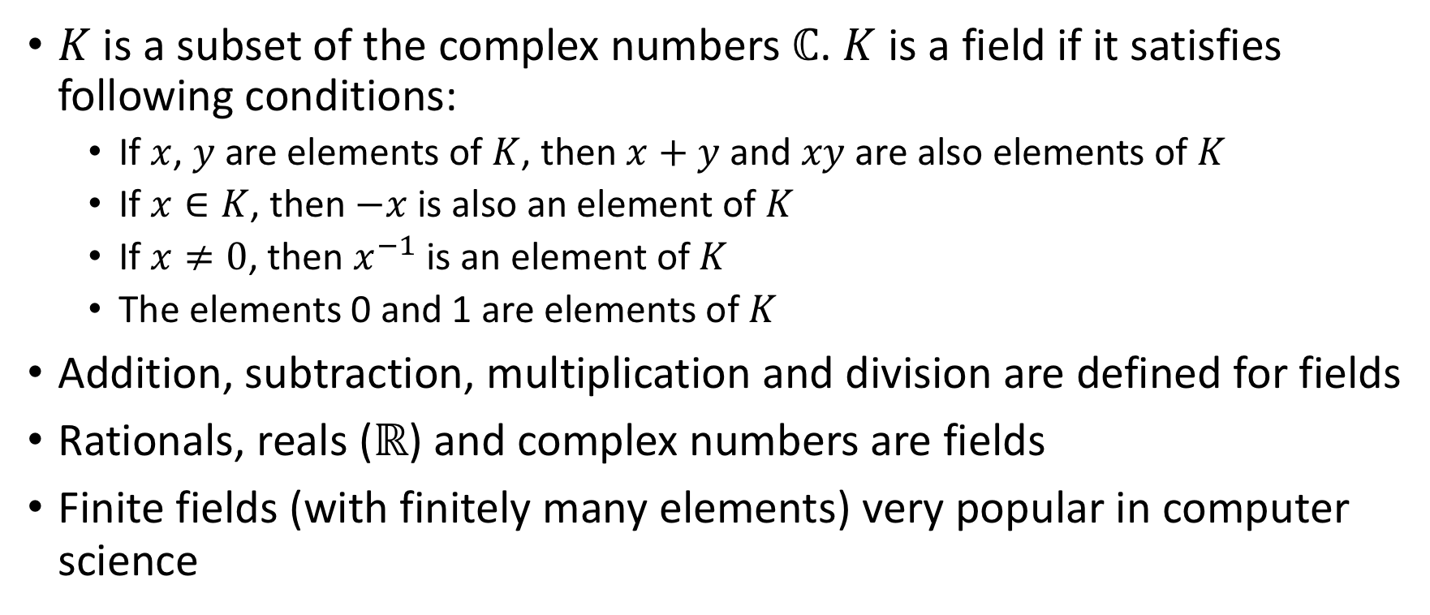
Fields
$K$ is a subset of the complex numbers $ℂ$. $K$ is a field if it satisfies following conditions:
If $x$, $y$ are elements of $K$, then $x+y$ and $xy$ are also elements of $K$
If $x∈K$, then $−x$ is also an element of $K$
If $x≠0$, then $x^{−1}$ is an element of $K$
The elements 0 and 1 are elements of $K$
Addition, subtraction, multiplication and division are defined for fields
Rationals, reals ($ℝ$) and complex numbers are fields
Finite fields (with finitely many elements) very popular in computer science

Slide 8
GF(2)
Galois field of two elements 0 and 1
Addition id element 0 and inverse, multip. id 1 and inverse (except 0)
+ | 0 | 1
0 | 0 | 1
1 | 1 | 0
x | 0 | 1
0 | 0 | 0
1 | 0 | 1
Addition
Multiplication

Slide 9
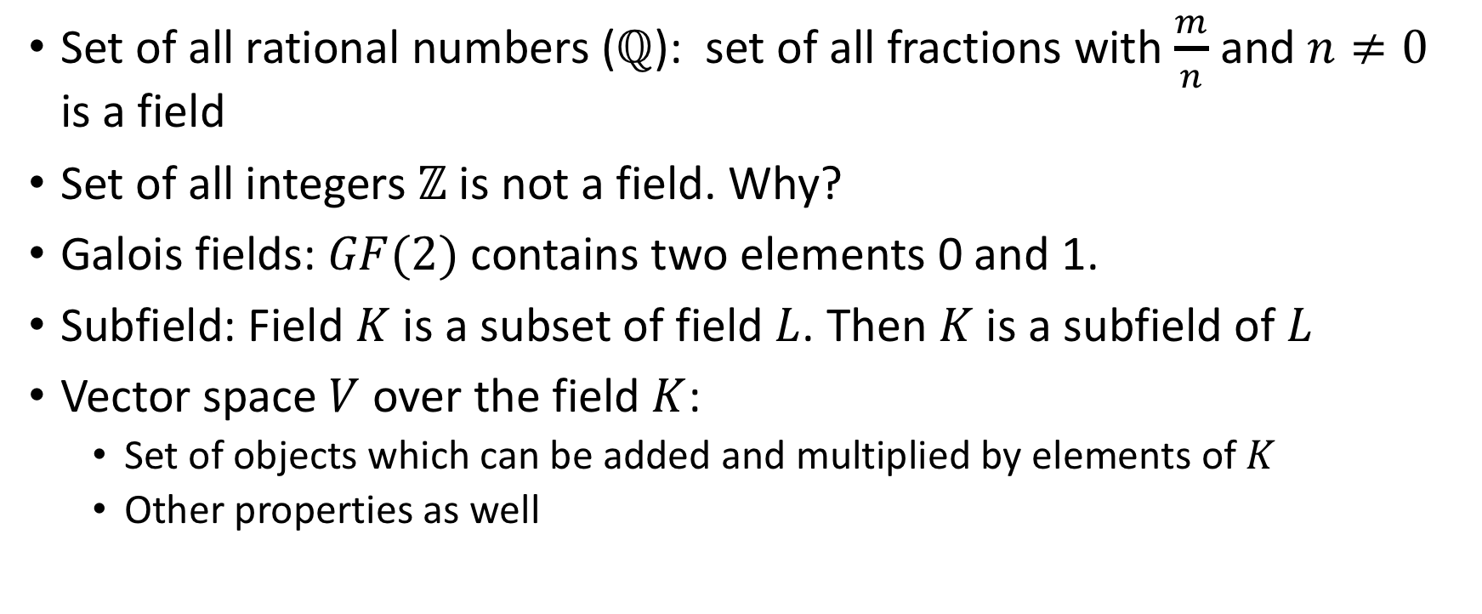
Fields (contd.)
Set of all rational numbers ($ℚ$): set of all fractions with $\frac{m}{n}$ and $n≠0$ is a field
Set of all integers $ℤ$ is not a field. Why?
Galois fields: $GF(2)$ contains two elements 0 and 1.
Subfield: Field $K$ is a subset of field $L$. Then $K$ is a subfield of $L$
Vector space $V$ over the field $K$:
Set of objects which can be added and multiplied by elements of $K$
Other properties as well

Slide 10
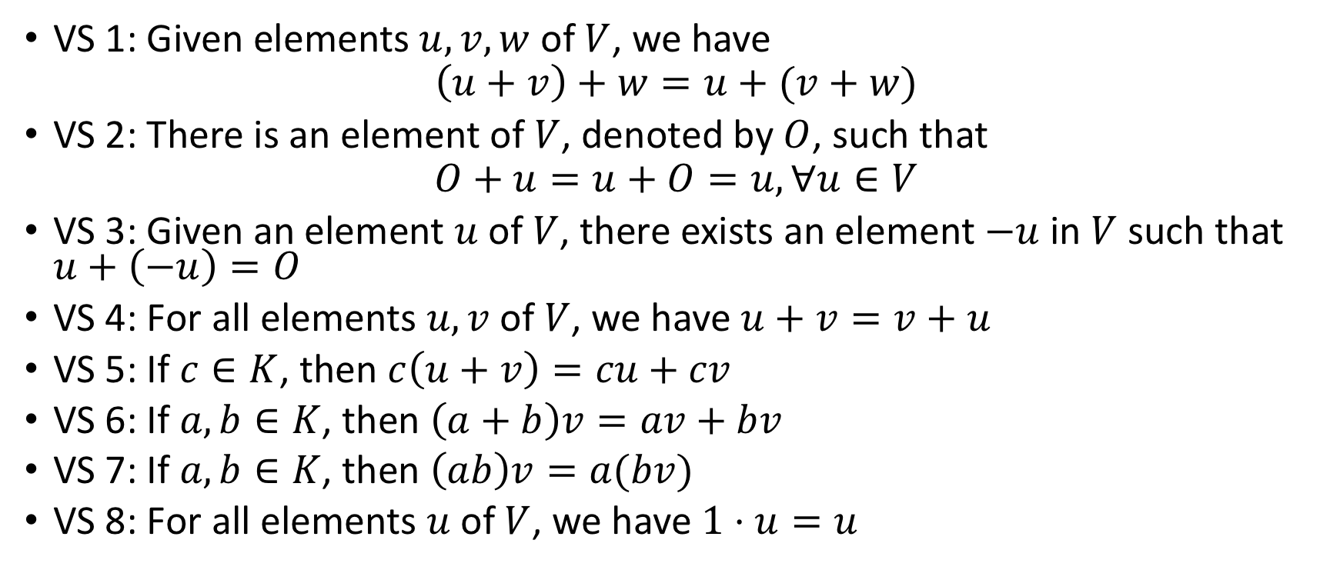
Vector spaces
VS 1: Given elements $u, v, w$ of $V$, we have
$$\left(u+v\right)+w=u+(v+w)$$
VS 2: There is an element of $V$, denoted by $O$, such that
$$O+u=u+O=u, ∀u∈V$$
VS 3: Given an element $u$ of $V$, there exists an element $−u$ in $V$ such that $u+\left(−u\right)=O$
VS 4: For all elements $u, v$ of $V$, we have $u+v=v+u$
VS 5: If $c∈K$, then $c\left(u+v\right)=cu+cv$
VS 6: If $a,b∈K$, then $\left(a+b\right)v=av+bv$
VS 7: If $a,b∈K$, then $\left(ab\right)v=a(bv)$
VS 8: For all elements $u$ of $V$, we have $1⋅u=u$

Slide 11
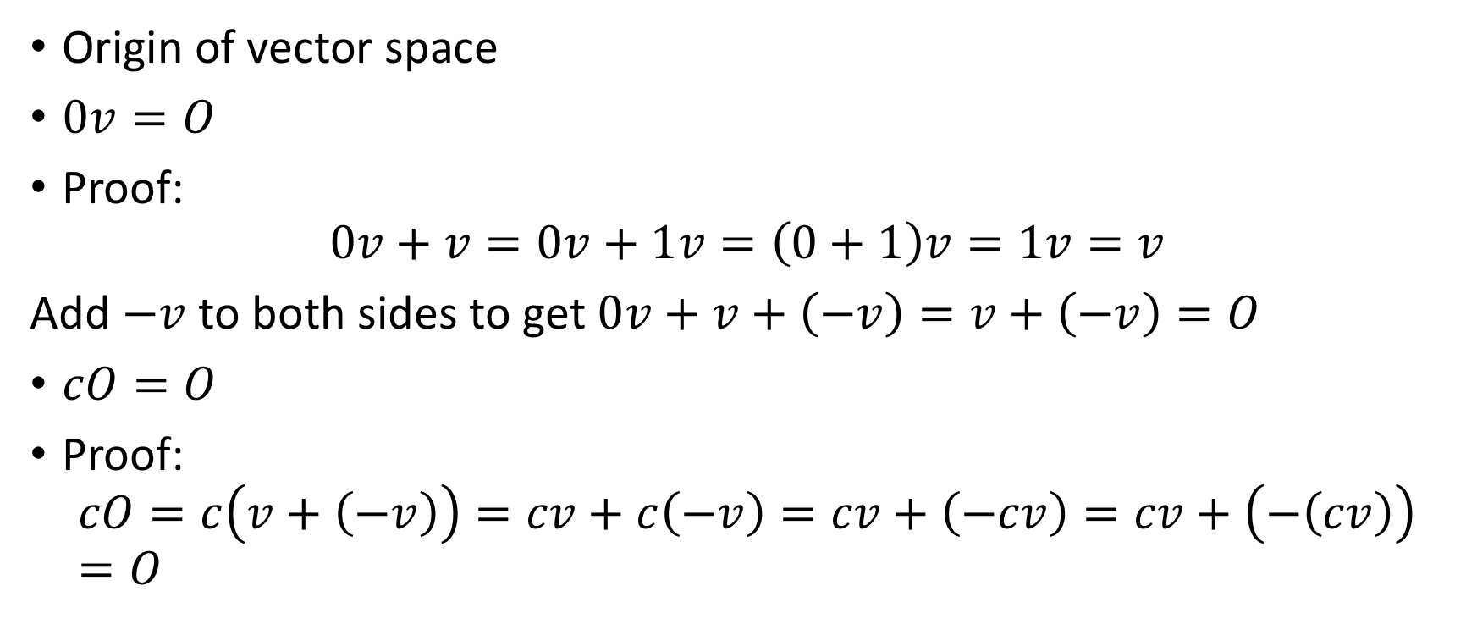
Example
Origin of vector space
$0v=O$
Proof:
$$0v+v=0v+1v=\left(0+1\right)v=1v=v$$
Add $−v$ to both sides to get $0v+v+\left(−v\right)=v+\left(−v\right)=O$
$cO=O$
Proof:
$$cO=c\left(v+\left(−v\right)\right)=cv+c\left(−v\right)=cv+\left(−cv\right)=cv+\left(−\left(cv\right)\right)=O$$

Slide 12
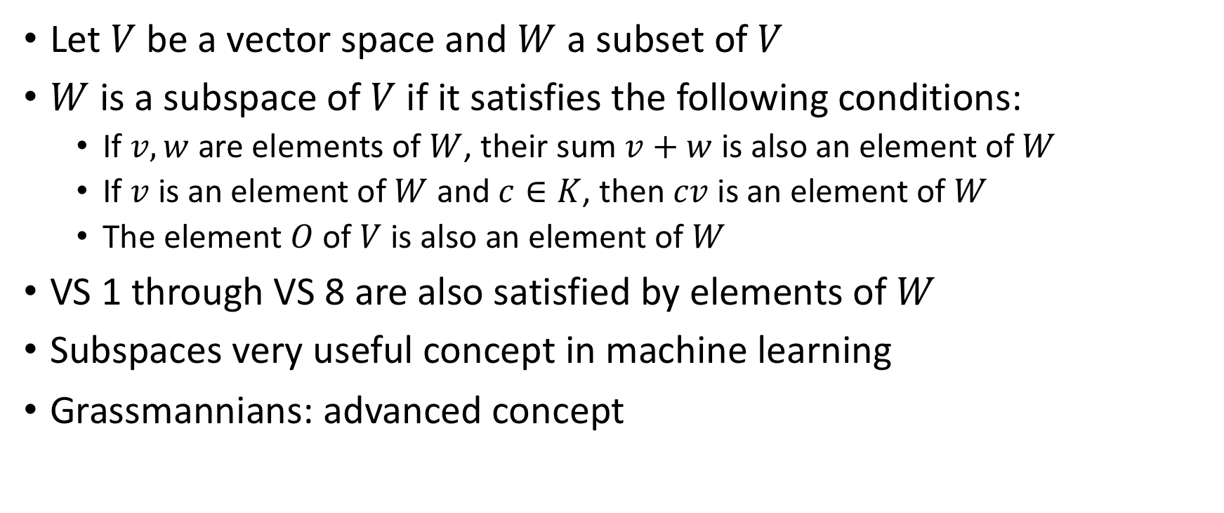
Introduction to Subspaces
Let $V$ be a vector space and $W$ a subset of $V$
$W$ is a subspace of $V$ if it satisfies the following conditions:
If $v,w$ are elements of $W$, their sum $v+w$ is also an element of $W$
If $v$ is an element of $W$ and $c∈K$, then $cv$ is an element of $W$
The element $O$ of $V$ is also an element of $W$
VS 1 through VS 8 are also satisfied by elements of $W$
Subspaces very useful concept in machine learning
Grassmannians: advanced concept

